Slide 1

TECHNICAL TASK
Predicting Medals for Great Britain in Tokyo 2025 World Athletics Championships
Usman Tariq (Data Scientist Candidate)
Notes:
The technical task is distributed in 3 parts.

Slide 2

Objective
Objective: To predict how many medals Great Britain’s track and field team is likely to win at the 2025 Outdoor World Athletics Championships in Tokyo.
Why it matters: Helps inform training priorities, resource allocation, and performance strategy.

Slide 3
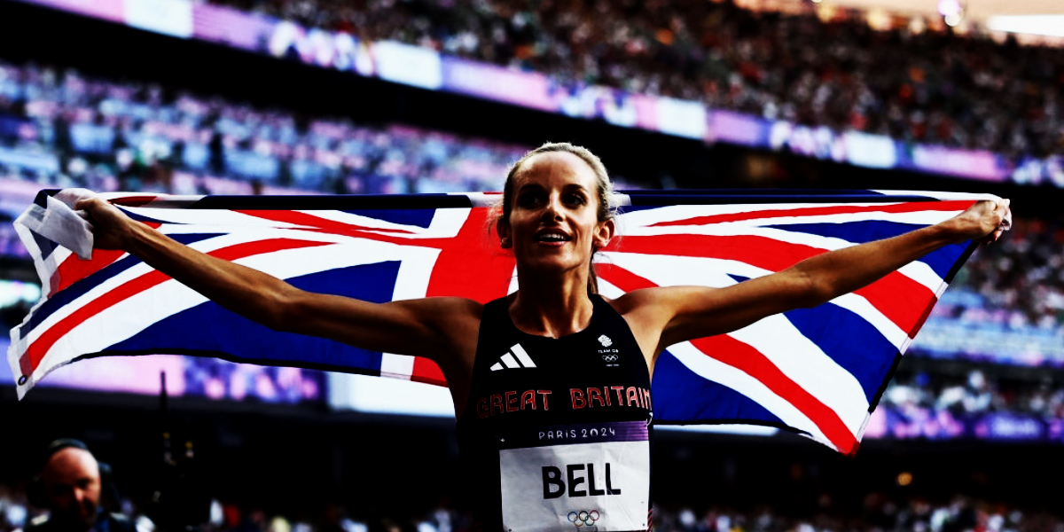

Track & Field Events Considered
The analysis and presentation focus exclusively on the following 19 Track and Field events:
100m,
110m Hurdles,
100m Hurdles,
200m,
400m,
400m Hurdles,
800m,
8. 1500m,
9. 3000m Steeplechase,
10. 5000m,
11. 10000m,
12. High Jump,
13. Pole Vault,
14. Long Jump,
15. Triple Jump,
16. Shot Put,
17. Discus Throw,
18. Hammer Throw,
19. Javelin Throw
Notes:
Only 19 Track and Field events that are considered for this analysis and presentation. Any insights, visualisations, or discussions you see moving forward are restricted to these events.

Slide 4

Part 01:
Problem Question
How many medals Great Britain are likely to win and in what events GB might win them at the 2025 Outdoor World Athletics Championships?
Notes:
Before answering the question, it is very important to understand GB’s historical performance in the same events. Because in Data Science we analyse the historical data to predict the future and to make much better informed decisions unlike the conventional way. So let’s delve into it.

Slide 5
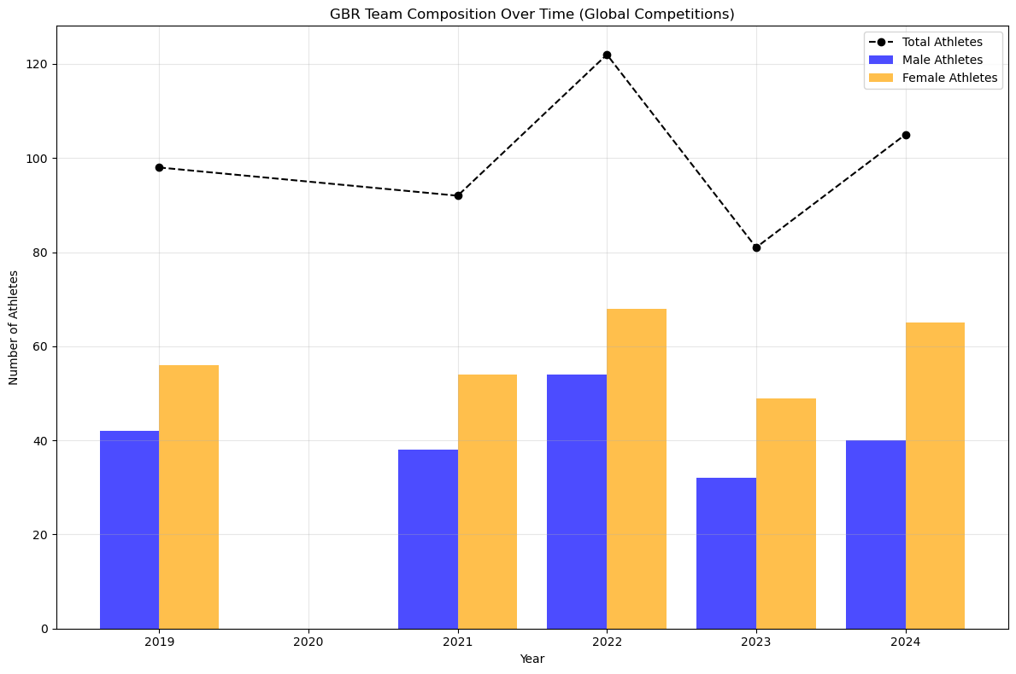
GB Team Participation Trends in Global Competitions (2019–2024)
The total athlete count peaked in 2022
Female Athletes consistently outnumber male athletes
Notes:
This slide illustrates that Over time, the composition of the GBR team in global competitions has varied, with a consistent trend of female athletes outnumbering male athletes in several years, particularly 2019, 2021, and 2024. The total athlete count, shown by the dashed line, peaked at 121 in 2022 before dipping to 80 in 2023, followed by a recovery in 2024.
These trends highlight the strong contribution of female athletes

Slide 6
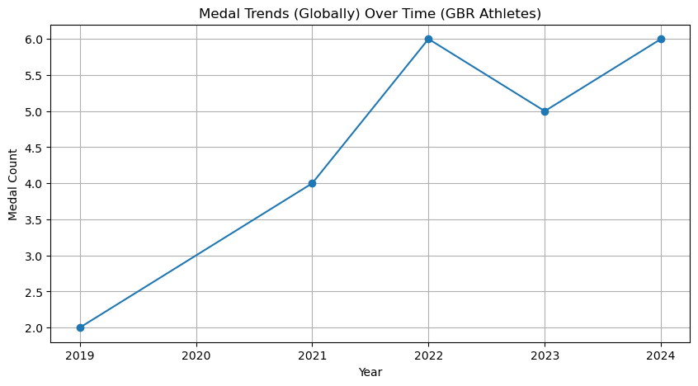
Historical Medal Trend
A total of 23 Medals from 2019 to 2024
Notes:
Please note that this analysis is solely on the basis of the data that was provided and can have some anomaly.The historical medal trends for GBR athletes from 2019 to 2024.
The graph indicates a steady improvement in medal count, starting with 2 medals in 2019 and rising to 6 medals in 2022..
This upward trajectory suggests consistent progress over time

Slide 7
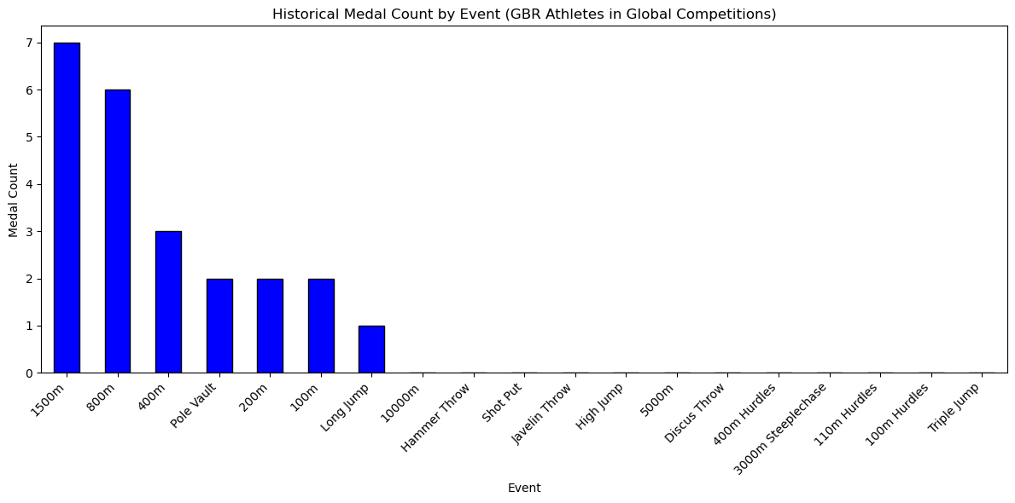
Historical Medal Count by Event
A total of 23 Medals from 2019 to 2024
Notes:
23 medals. The 1500m and 800m events lead with 7 and 6 medals respectively, followed by strong performances in the 400m and Pole Vault.
However, there are notable gaps in events like the Hammer Throw, Shot Put, Javelin Throw, and Triple Jump, where no medals have been achieved. These areas highlight opportunities for improvement and focused development to enhance GBR’s medal potential in future competitions.

Slide 8
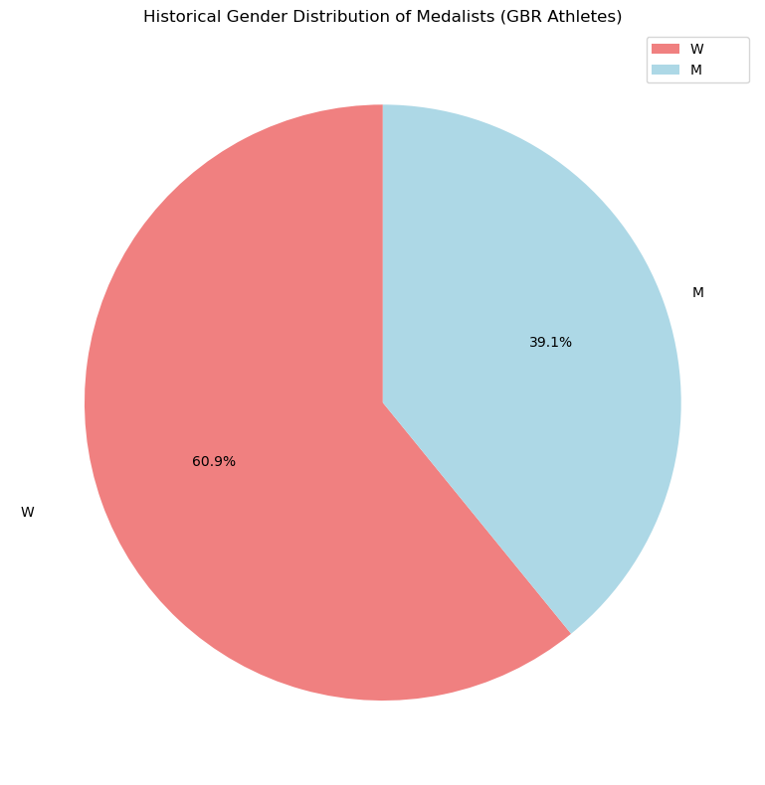
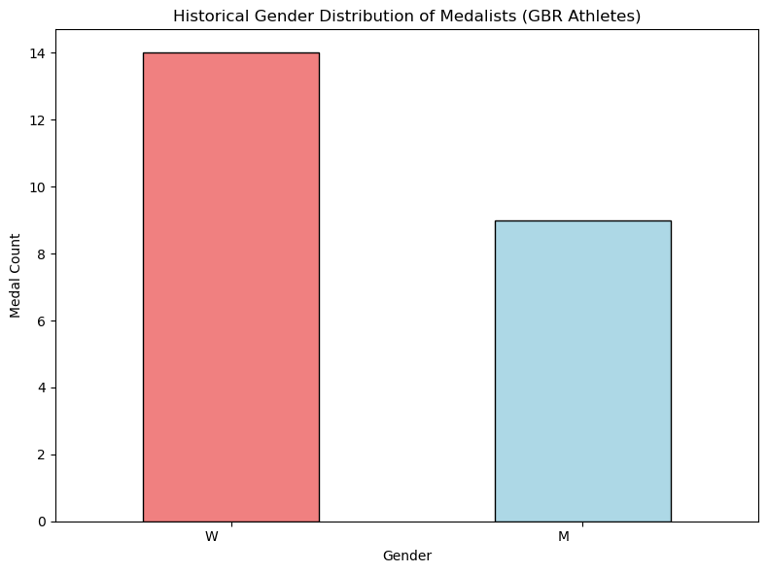
Historical Gender Distribution of Medalists
Women Medalists are dominant
Notes:
The pie chart shows that female athletes account for 60.9% of the medals, while male athletes make up 39.1%.
This trend is reinforced by the bar chart, which shows women winning 14 medals compared to 9 medals for men.
These insights suggest that female athletes have had a stronger representation and success rate historically.
Understanding these trends can help guide predictions for future events and inform decisions around resource allocation and training focus to optimise performance outcomes.

Slide 9
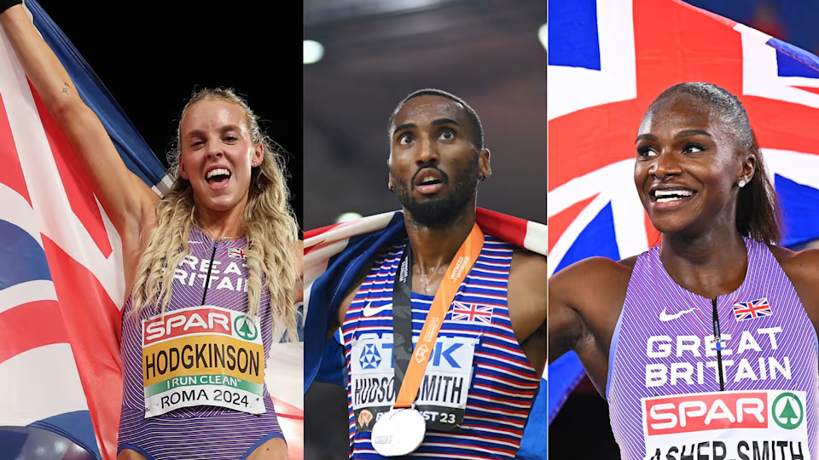
The Prediction
In 2025 Tokyo World Championships Great Britain is likely to win..

Slide 10
The Prediction
8 Medals in 6 Events
In 2025 Tokyo World Championships Great Britain is likely to win
Notes:
And yes, spoiler alert, Keely is one of the predicted winners.

Slide 11
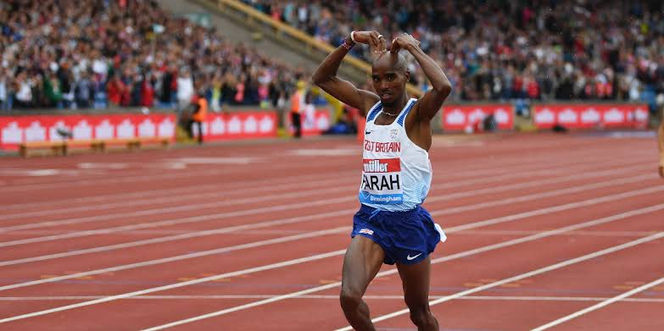
The Prediction
10000m,
5000m,
1500m,
800m,
400m and
Pole Vault
In 2025 Tokyo World Championships Great Britain is likely to win in 6 Events:

Slide 12
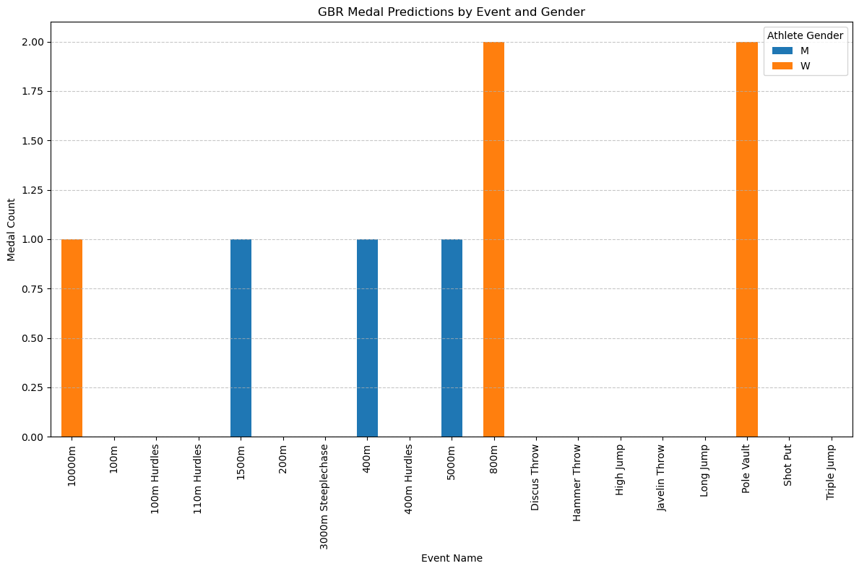
Bar Chart: Medal Predictions by Event
Notes:
The 800m and Pole Vault events stand out, with women predicted to secure 2 medals each.
On the men’s side, medals are distributed across events like the 1500m, 400m, and 5000m, each contributing 1 medal.
The chart highlights events where GBR athletes are likely to excel,
while also revealing gaps, particularly in disciplines like Shot Put, Triple Jump, and Javelin Throw, where no medals are currently predicted.
This insight provides focus areas for future improvement and targeted development.

Slide 13
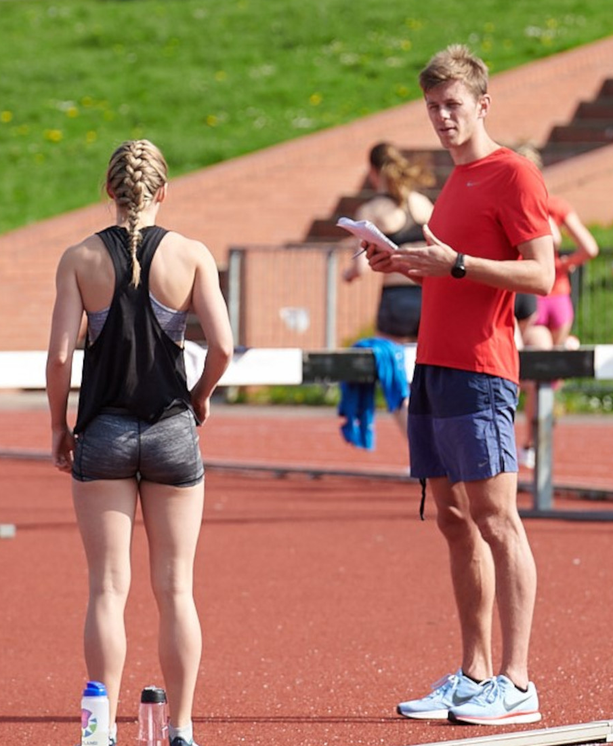
Why this Matters
Focus Training on High-Potential Events
Allocate Coaching & Support Resources Effectively
Improve in the events GB is unlikely to win a medal.
Notes:
This Data informed Prediction helps us, the team and the performance coaches to focus in the right areas

Slide 14
Part 02: The Process

Slide 15
Methodology
Evaluation & Visualisation
Modeling & Prediction
Business Understanding
Key performance question.
05
01
04
Data Analysis & Visualisation
Understanding historical trends and numbers
Data Understanding
Data Exploration and restructuring
02
03
Data Cleaning & Preparation
Notes:
I followed a systematic and logical approach to tackle the Business Problem. I used tools like Python, SQL and Excel.

Slide 16
Data Sources
Datasets Used:
GBR Competition Results (CSV): British athlete performances (2019–2024).
Global Competition Results (CSV): International results for comparison.
GBR Athlete List
Global Athlete List (CSVs)
Notes:
4 datasets were provided

Slide 17
Business Understanding
Key Performance Question: 2 Parts
Medal Likelihood in 2025 Tokyo Championship.
In what Events.
All the Data Design would revolve around that question.
Notes:
The task has 2 important parts to focus on. One also hints towards a ‘Global’ event.

Slide 18
2. Data Understanding
Data Loading
Data Exploration
Data Integration
Athletic List with Competition Results to create two datasets
Concatenating the above 2 datasets (GBR and Global)
Introducing flag columns
Notes:
Data Joining: The first joining was on the basis of mutual key: AthleteGUID
Then, I concatenated the two datasets so that I don’t lose any important information for both domestic/national and international/global events.

Slide 19
3. Data Cleaning & Preparation
Data Filtering
Relevant Track and Field Events and Valid Performances
.
2. Dropping unnecessary columns
Decision: Drop Columns: Valid Performance, Competition Name as they are not relevant. CompName: CompID is there to identify the competition
3. Format Standardisation
Datetime format, numericals, categorical
Decision: Not to standardise Performance Units because they convey different/logical information.
4. Treating Special Characters
Extra spaces, lowercase, special characters in strings.
5. Treating Duplicated Rows
Notes:
Step wise approach:
Format Standardisation: Converting Date columns to standard datetime format, ensuring numerical columns are in float or integer types and Categorical Columns like Gender.
Decision taken to keep time based events in seconds and distance based in metres as they were for natural and logical information.
Treating Special Characters: removing extra spaces, converting to lowercase, and removing special characters in string columns.
Treating Duplicated Rows: Removed duplicated rows to ensure well structured dataset as per Wickham’s Tidy Data Construct

Slide 20
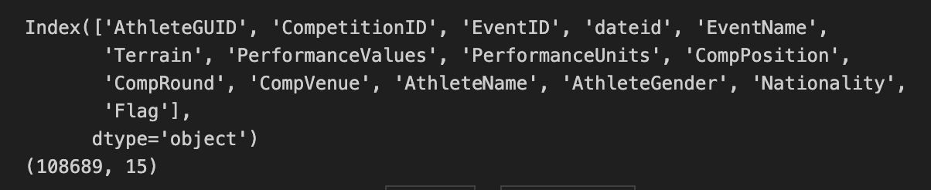
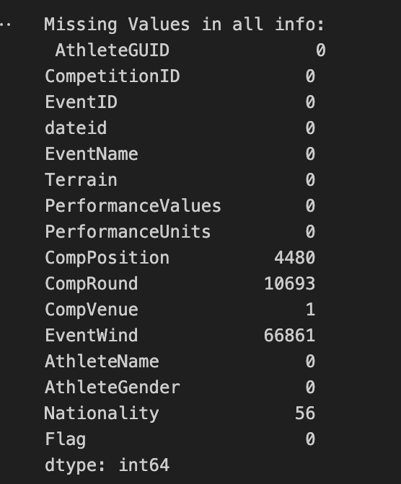
3. Data Cleaning & Preparation
6. Treating Missing Values
Decision: Dropped EventWind Column as it had 66,861 Null values and a very Weak Correlation Value with Performance Values: -0.0095
Columns Dropped:
Competition Round with Null values
Rows Dropped:
Competition Venue with only 1 Null value
Competition Position with Null values, 0 & -1
Nationality: Imputed with a placeholder ‘unknown’
Notes:
Missing Values: An extremely weak correlation value of 0.0095 shows that there is no impact of EventWind on the Performance Values, hence, can be dropped.
After treating Missing values, the dataset had 95,721 rows.
It was imperative to have the sequence as mentioned. Example: Treat Duplicates before treating Missing values or else averages in imputation would be wrong.

Slide 21
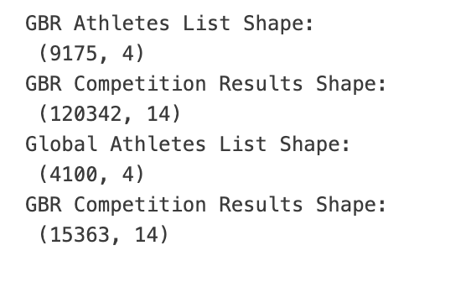
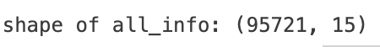
4. Data Analysis & Visualisation
Analysing the Cleaned Data
From 4 dirty datasets to one cleaned dataset
Wickham’s ‘Tidy Data’ Principle Structure
Structurally Ready to solve the BP
Visualisations
Illustrated in Part 1
Notes:
After Cleaning, the data was ready to be analysed and to perform feature engineering for the prediction.
From 4 dirty datasets to one cleaned dataset which is structurally ready to solve our business Problem.

Slide 22
5. Data Modeling
High-level Approach
Performance Analysis
Medal Prediction

Slide 23
5. Data Modeling & Prediction
Goal: Find top 3 performers globally
Performance Analysis Steps
Filter the cleaned Data for Final Round Only (Medal Contenders)
Classifying data by Event Type (time and distance)
Finding Global Top 3 Performers
Notes:
The performance analysis process involved a systematic evaluation of GBR and global athletes’ performances to identify competitive trends and strengths.
1. The first step filtered the data to focus exclusively on athletes competing in the final rounds, as these represent the most relevant results for medal contention.
2. Events were then categorized into time-based and distance-based based on the performance units.
3. Performance Values were used to rank top 3 athletes globally per event and gender by introducing another attribute ‘RankValue’ which ranked on the basis of Performance Values and not Competition Position which could be misleading.
This process highlighted GBR athletes achieving competitive results and assessed their standing relative to the global field.

Slide 24
5. Data Modeling & Prediction
Medal Prediction
Defining Medal/Performance Thresholds
Derived from top 3 global performances
Different Thresholds for time-based and distance-based events
Identify GBR Athletes Meeting Medal Thresholds
Notes:
1. Medal Prediction is linked to the Performance Analysis. The medal prediction step introduced a threshold-based approach to identify GBR athletes most likely to win medals. Thresholds were derived from the top three performances globally in each event and gender: for time-based events, the third-lowest performance was used as the benchmark, while for distance-based events, the third-highest performance served as the threshold.
2. The thresholds were merged into the final-round data, and GBR athletes were filtered based on performances meeting or exceeding these benchmarks.
This process highlighted athletes who met global medal standards, presenting a clear picture of GBR athletes’ medal potential solely based on the data.

Slide 25
Simply Put..
Analytically narrowed down historical performance data to top 3 grouped by event and gender.
Set Thresholds per event, event type and gender after rigorous analysis and problem-solving.
Predictions for medals for GBR Athletes if they met or exceeded the Threshold.

Slide 26
Limitations
Solely based on provided data
Fixed thresholds for predictions
Emerging Athletes not considered
Ignores injuries and current form of Athletes
Real world factors overlooked
Retired Athletes could be in the Data
Notes:
1. It is solely based on the provided data, which may not represent all real-world scenarios.
2. The thresholds used for medal predictions are fixed which gives fixed number of medal predictions and not a range.
3. Emerging athletes from other countries are not considered, which could influence the benchmark set and change the prediction.
4. The analysis does not factor in injuries or the current form of athletes, which are crucial for performance evaluation.
5. Real-world factors that may impact results have been overlooked, as the focus is purely on historical data.
6. Retired Athletes in the data could affect the predictions and the thresholds set.

Slide 27
Part 03: Key Questions for Coaches and Performance Team
Notes:
In the Final part I have some key questions for UK Athletic Coaches and Performance Leadership Team that would help further inform my modelling approach.

Slide 28
Key Questions
What additional factors impact an athlete’s performance?
How are current athlete performances being monitored?
How do we assess an athlete’s current form leading into major competitions?
What specific support systems are in place for athletes underperforming or on the cusp of medal contention?
Notes:
These questions can help the modelling approach with better and realistic results. For example, Q1
Factors like injuries, training schedules, mental fitness, and environmental conditions are not included in the current model. Insights into these elements can enhance the model’s ability to predict medal outcomes more realistically.
Understanding the existing metrics and tools used to evaluate athletes’ performances can help refine the accuracy of our prediction model by incorporating real-time performance data.
The model relies solely on historical data, but an athlete’s current form is often a key determinant of success. Feedback on methods to evaluate short-term performance trends can further refine the analysis.
Understanding support structures (e.g., training programs, recovery plans) for near-miss athletes can help interpret why some athletes meet or fail to meet thresholds.

Slide 29
Summary
Predicted Medals: ~8
Top Events:
W: 800m, Pole Vault, 10,000m,
M: 1500m, 400m, 5000m
Collaboration with coaches to integrate domain expertise.

Slide 30
Thankyou!
Questions? I look forward to hearing your insights.

